Slide 1
Ttile

Slide 2
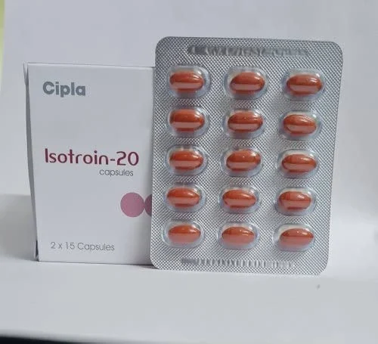
What is isotretinoin
Isotretinoin, sold under brand names like Accutane, is a potent oral retinoid medication primarily used to treat severe cases of acne. It is derived from vitamin A and works by reducing the size and activity of sebaceous glands, decreasing sebum production which in turn helps prevent acne.
Use: Initially designed for severe, nodular, or cystic acne that hasn't responded to other treatments, isotretinoin is now also prescribed for moderate acne in some cases.
Mechanism: Targets several acne-causing factors, including sebaceous glands.
Side Effects: It has significant side effects, including dry skin, lips and eyes, along with more serious risks like teratogenic effects (birth defects if taken during pregnancy) and potential mental health impacts. Regular monitoring by a healthcare professional is essential.
Monitoring: Patients often undergo regular blood tests to monitor for potential side effects, such as liver function abnormalities or changes in lipid levels.
Isotretinoin is considered the "nuclear option" for acne due to its effectiveness but is only used when other treatments fail or for particularly severe cases.

Slide 3
But why is isotretinoin considered controversial?
Some examples…
Severe Birth Defects (Teratogenicity)
Isotretinoin is highly teratogenic, meaning it can cause severe birth defects if taken during pregnancy.
Risks: Heart defects, cleft palate, brain abnormalities, and developmental delays in infants.
Regulations: Women of childbearing age must enroll in strict pregnancy prevention programs (e.g., iPledge in the U.S.) and adhere to regular pregnancy tests and contraceptive use. Despite these safeguards, concerns remain over accidental pregnancies.
Over-Prescription and Use in Less Severe Cases
Originally intended for severe, nodular, or cystic acne, isotretinoin is increasingly prescribed for moderate acne.
Criticism: Some argue that this use exposes patients to unnecessary risks when safer alternatives (like antibiotics or topical treatments) are available.
Support: Proponents argue that early use can prevent scarring and long-term psychological damage.

Slide 4
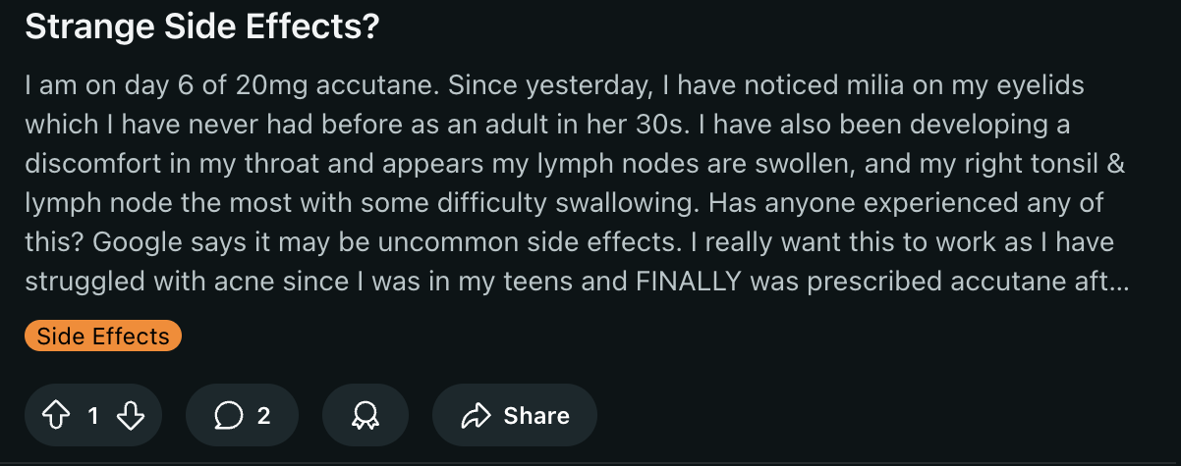
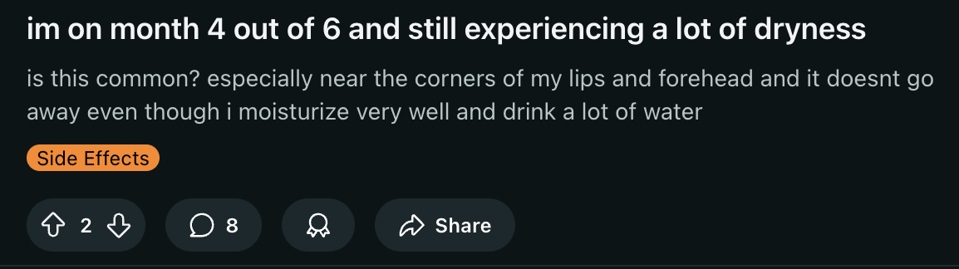
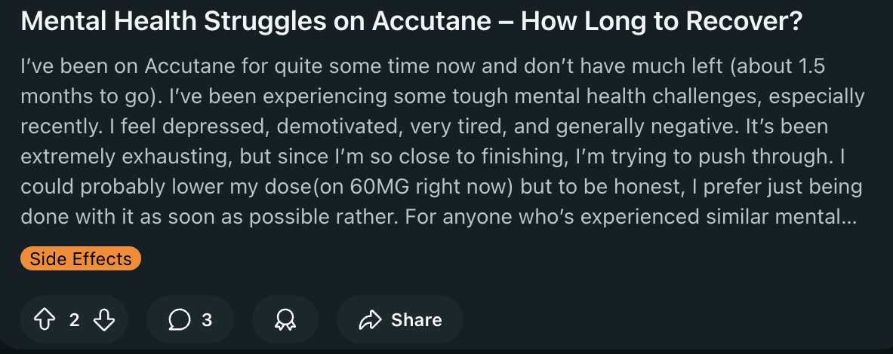
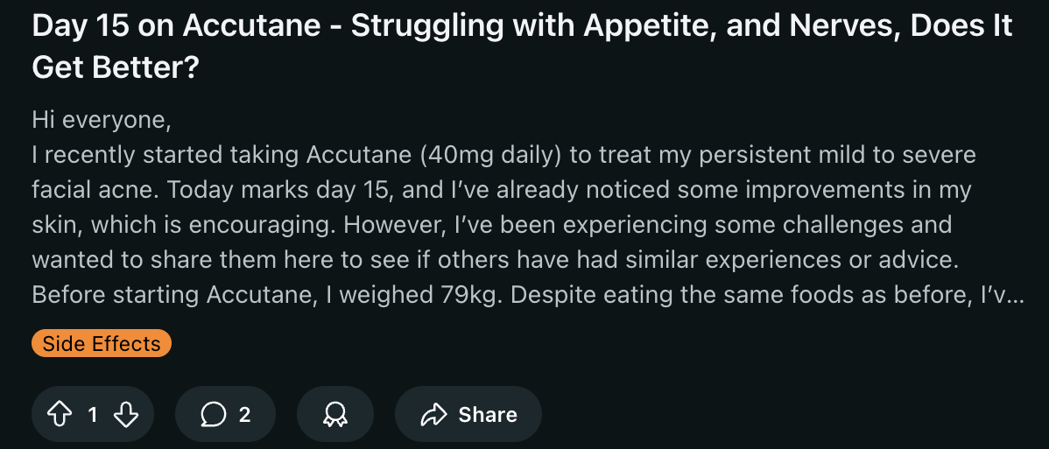

Slide 5
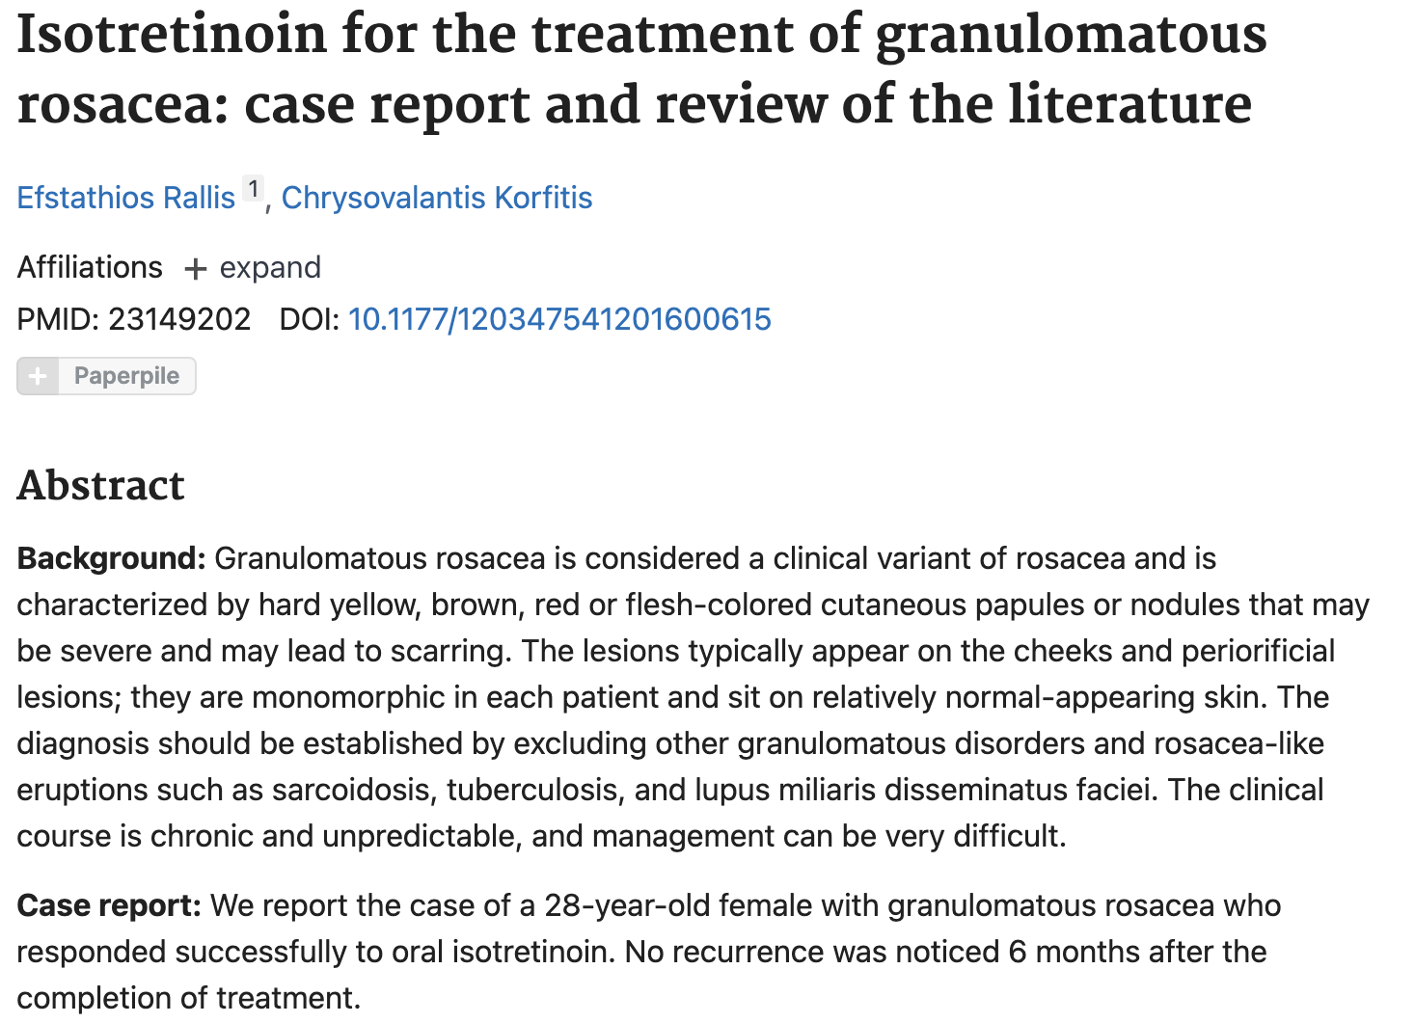
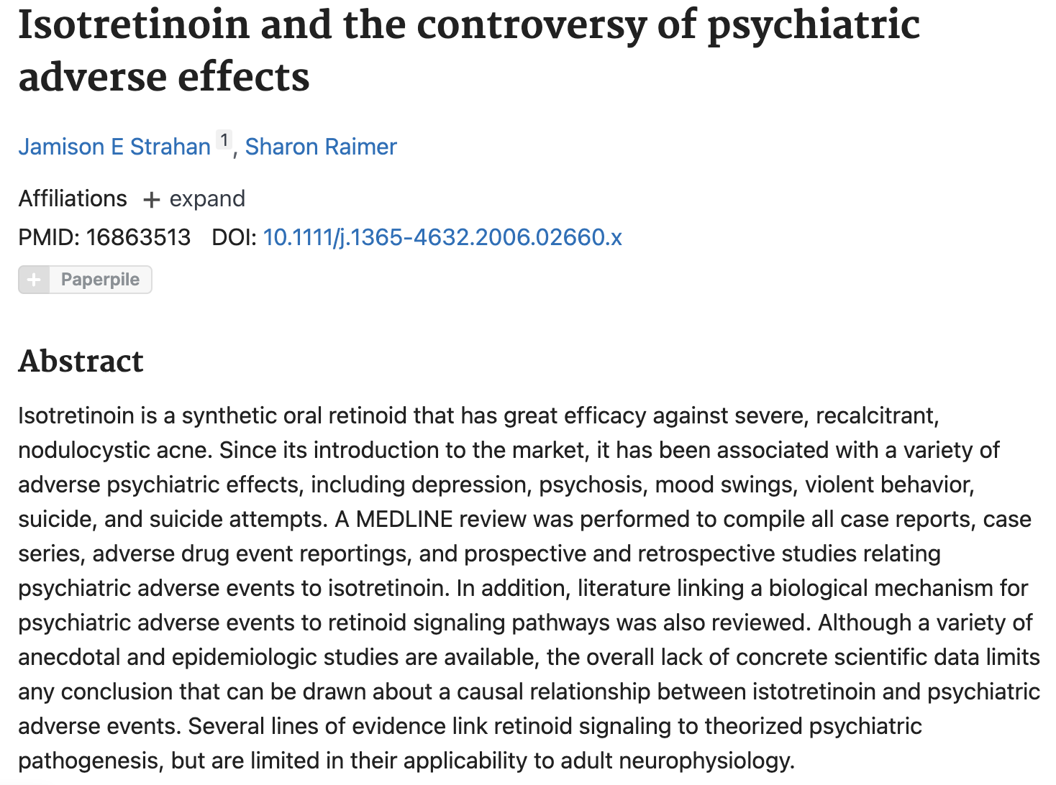

Slide 6
What do I want to find out?
Comparison of Sentiments Across Time (Pre- and Post-Regulation of the drug e.g. iPLEDGE)
Comparison of Sentiment Analysis to Other Treatments (adapalene, retinoic acid, etc.)
Comparison of topics and sentiments apparent in Reddit, Twitter and academic literature (only articles after the introduction of social media will be used to test this hypothesis)

Slide 7

The data

Slide 8
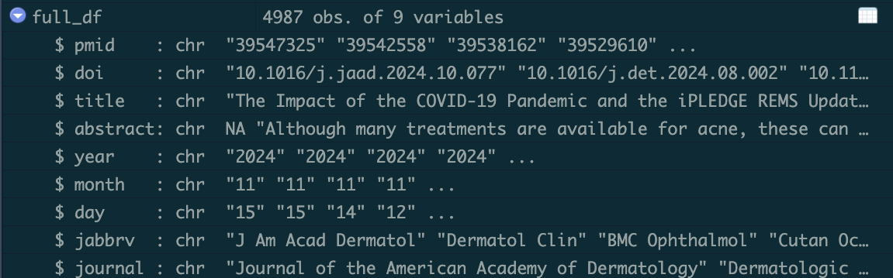
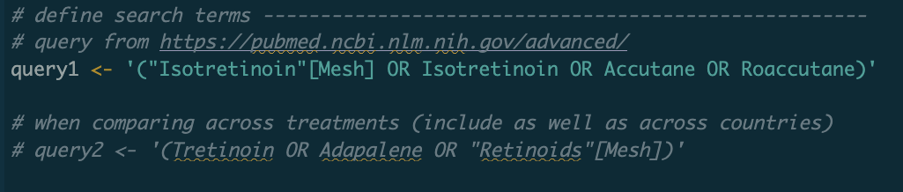
Where will the data come from

Slide 9
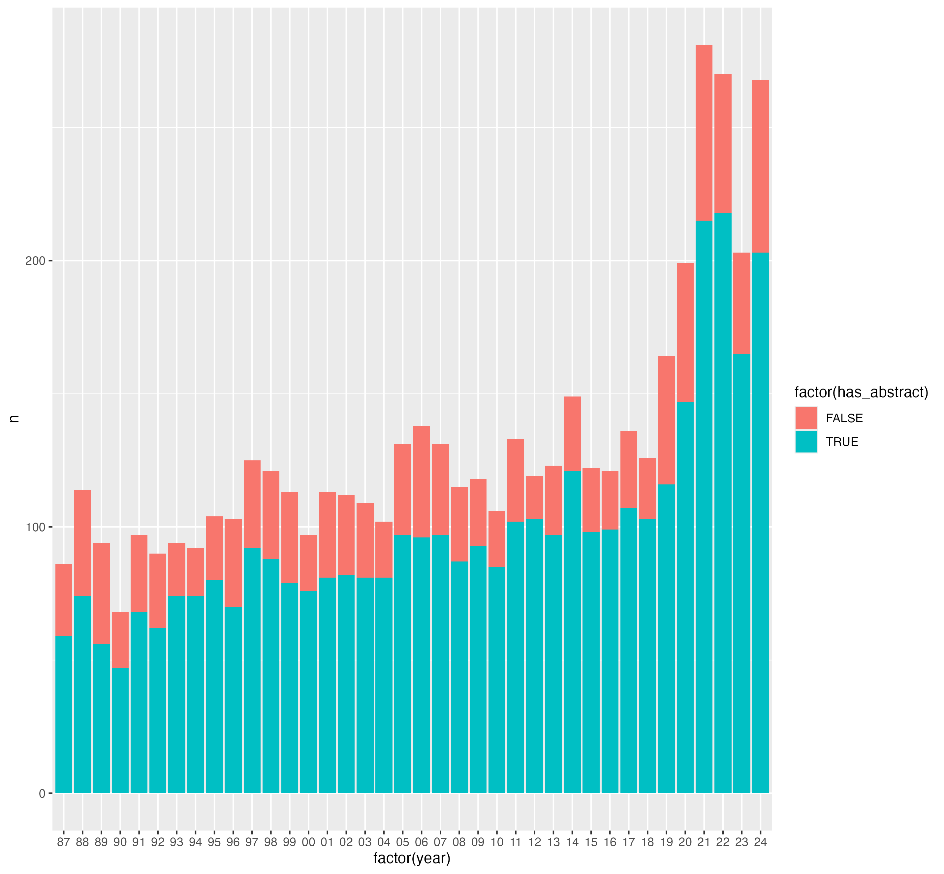
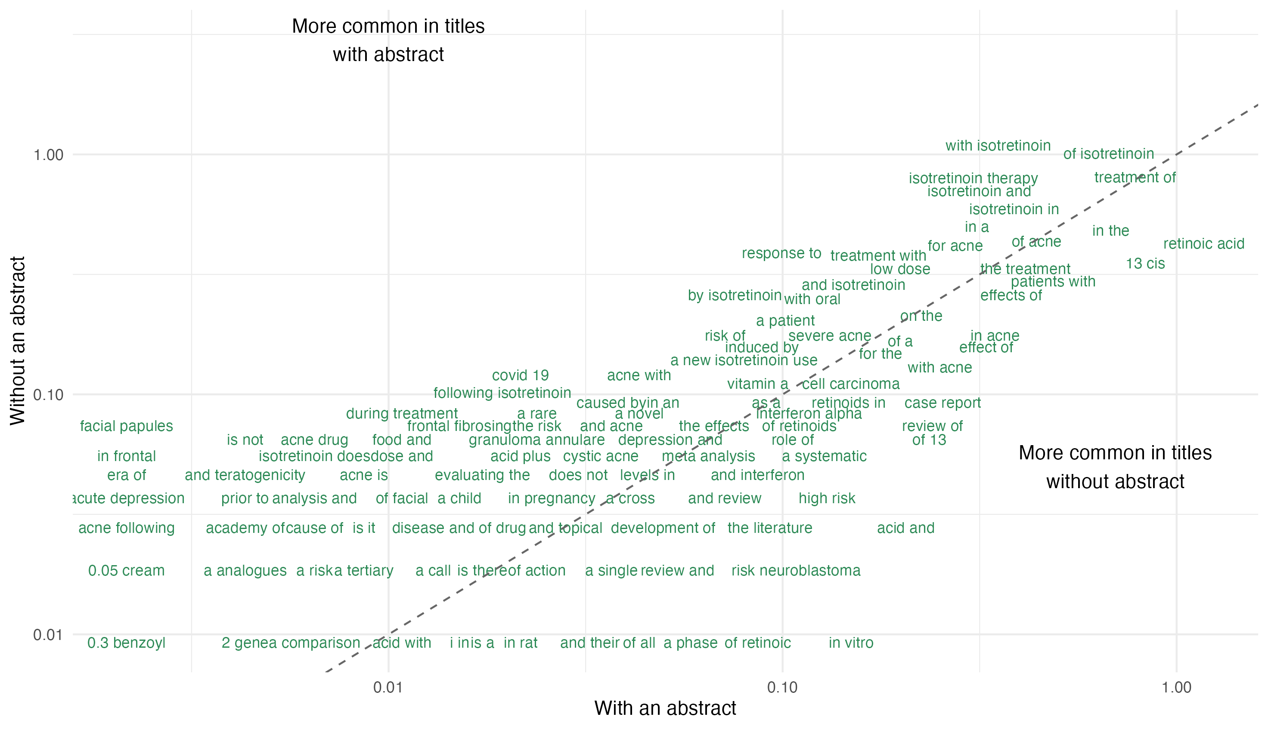
Interesting data so far …
No outliers of note, but may discuss further
35+ years of articles. Social media posts will only be compared to articles after its’ introduction.

Slide 10

Methods

Slide 11
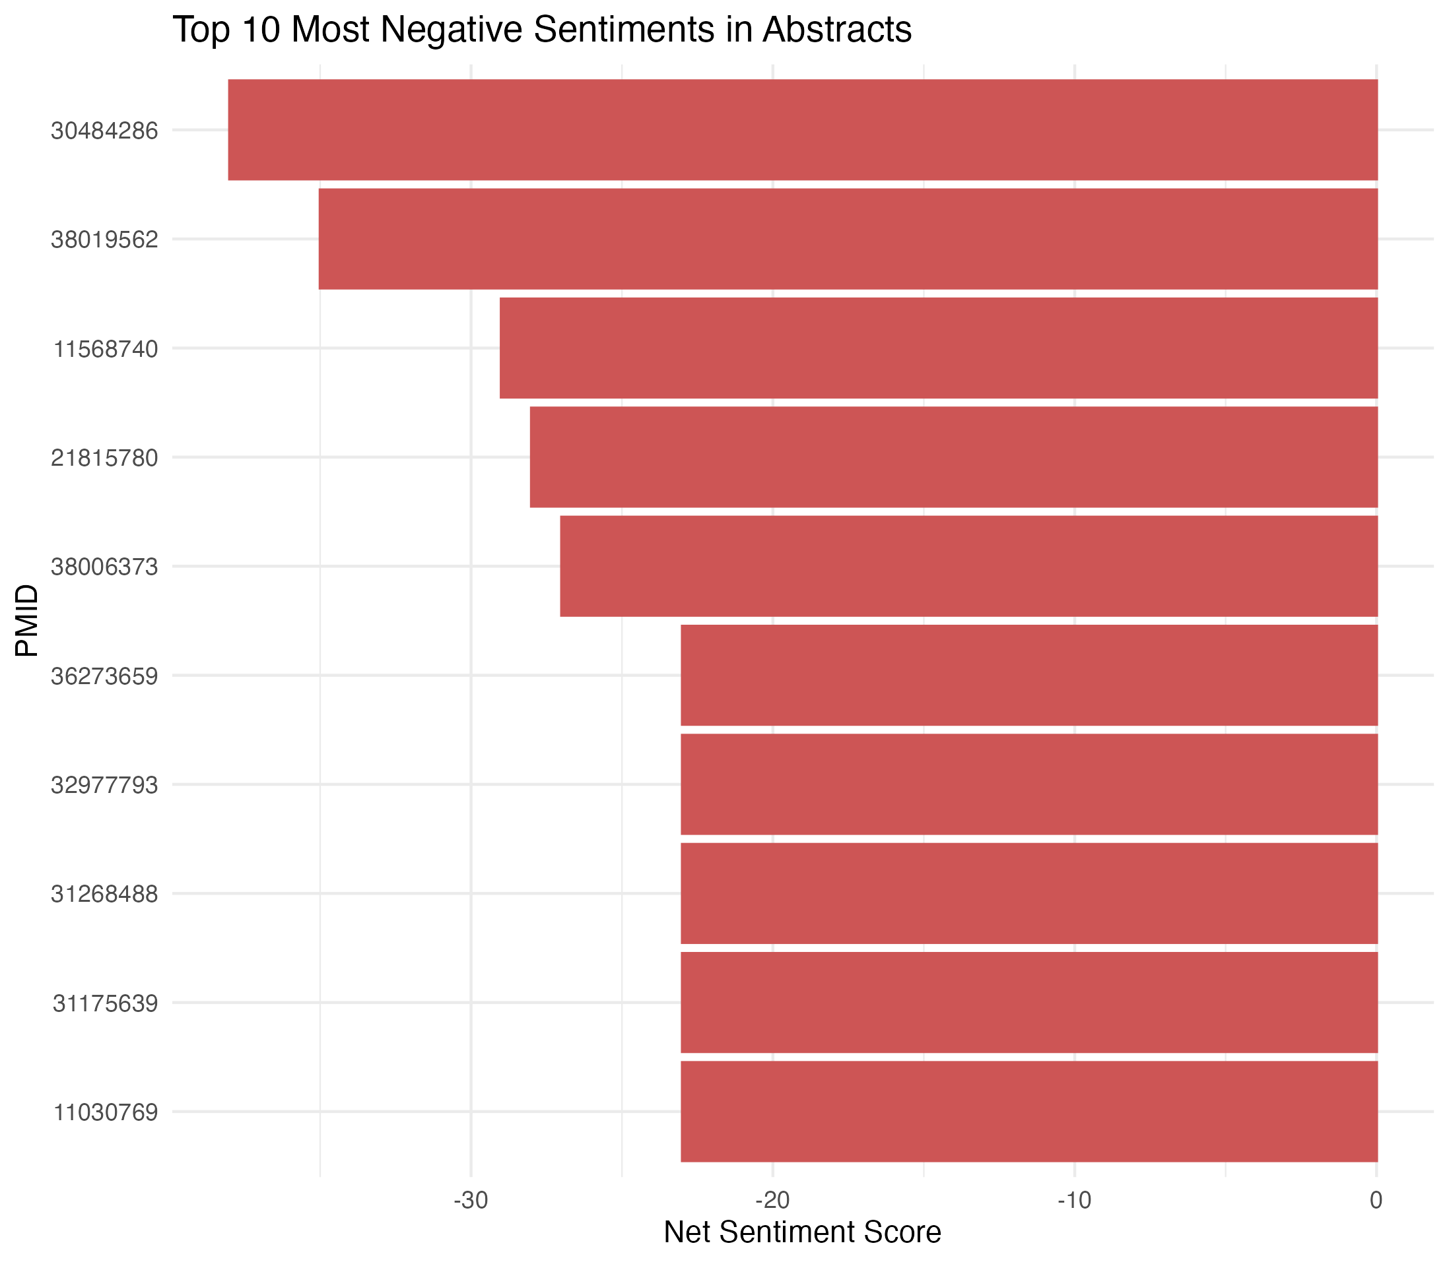
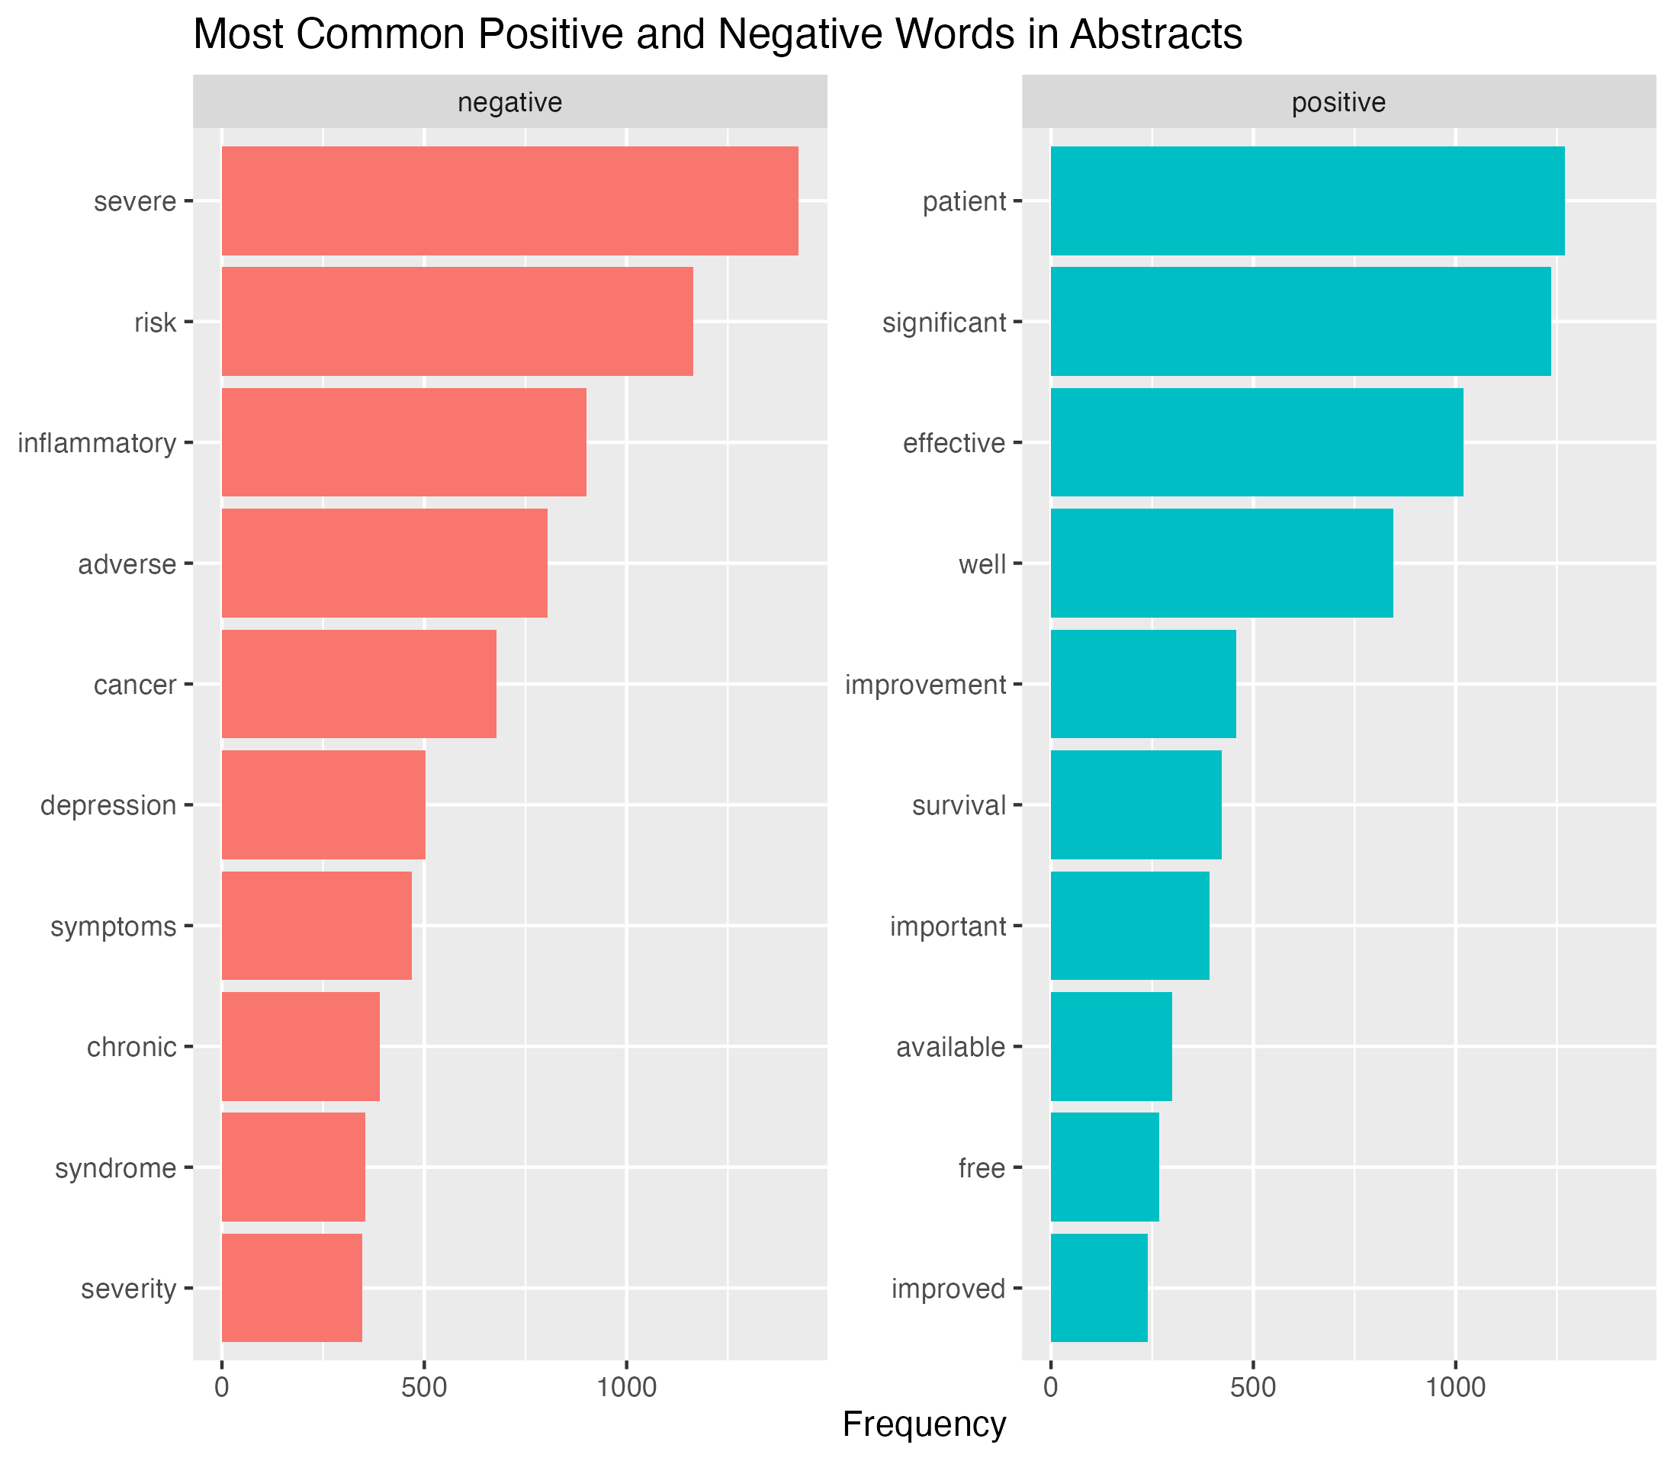
My methods so far …
PMID article numbers here will be good for my discussion section
Sentiment Analysis
Use Case:
Analyse the emotional tone of discussions around isotretinoin in social media posts, news articles, and literature.
Compare sentiment trends across different platforms or time periods.
Method: Use sentiment lexicons (e.g., NRC, Bing, AFINN) to identify positive, negative, or neutral sentiments.
I then plan to perform similar analysis on both reddit and twitter posts, for comparison. Statistical analysis will then be performed after to assess whether difference in sentiments is significant.

Slide 12
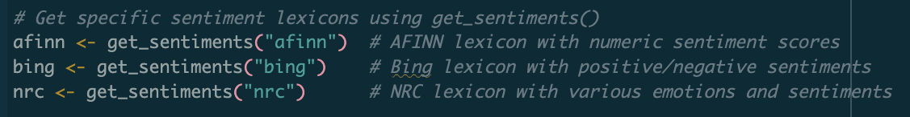
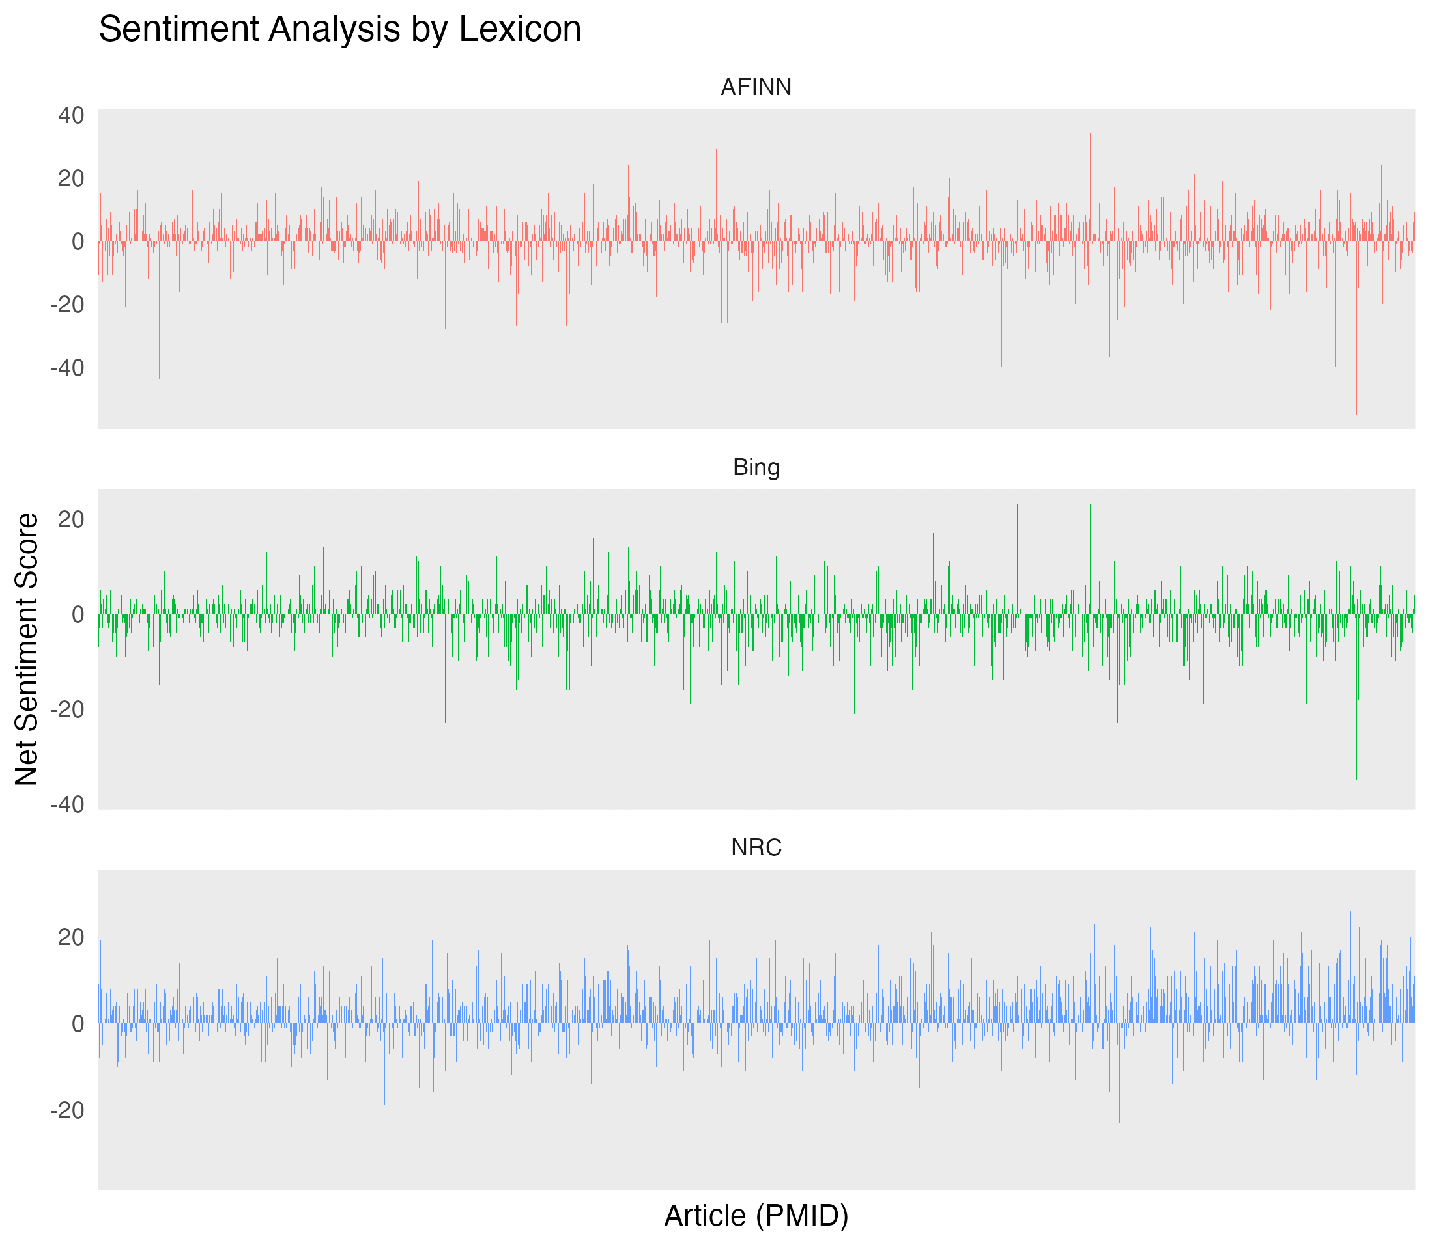
Sentiment lexicons
All sentiment lexicons appear to be similar.
This is good, but I am leaning towards using AFINN and NRC.
Bing is similar to AFINN but provides less insight.

Slide 13
Further methods
TF-IDF comparison
Use Case:
Identify key terms or phrases uniquely associated with isotretinoin in each source (social media, literature, news).
TF-IDF helps identify the most relevant terms associated with isotretinoin in each source type (literature, social media, news). It highlights how topics or terms differ across these contexts, offering insights into how isotretinoin is discussed in unique or shared ways.
Method:
Calculate term frequency-inverse document frequency (TF-IDF) to emphasize important words in context.
Topic Modelling with LDA
Use Case: Discover overarching themes about isotretinoin across abstracts and social media (potentially news articles but lack data for these + bias).
LDA (Latent Dirichlet Allocation) identifies topics as clusters of related terms, enabling a structured comparison of how isotretinoin is discussed in different contexts. This helps uncover shared or unique themes, offering insights into narratives that are present.
Method:
Apply LDA on pre-processed text data to extract latent topics. Each source is analysed independently to identify its dominant themes, represented by the most frequent and relevant terms in each topic. The results can highlight cross-source similarities and distinctions in how isotretinoin is portrayed or perceived.

